Slide 1
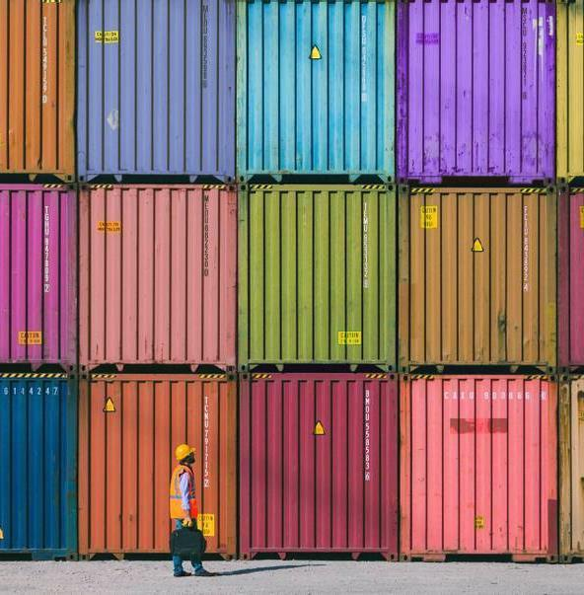
PUBLIC TRANSPORT
BY The_nerd

Slide 2
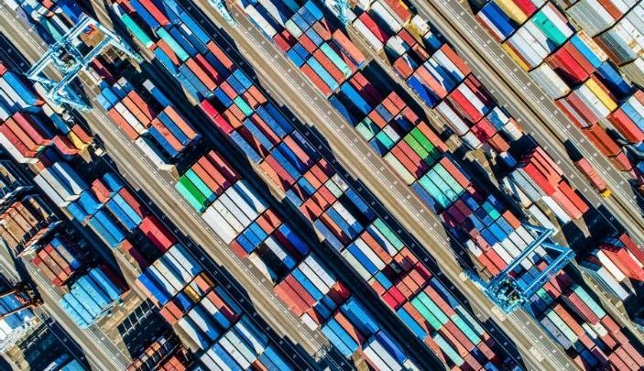
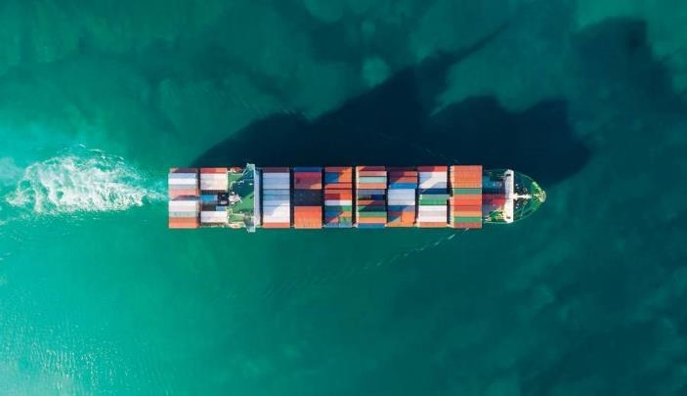
Agenda
TRANSPORT SOLUTIONS
Bus tracking SYSTEM

Slide 3
BACKGROUND
Vehicle tracking systems were first implemented for the shipping industry because people wanted to know where each vehicle was at any given time. These days, however, with technology growing at a fast pace, automated vehicle tracking system is being used in a variety of ways to track and display vehicle locations in real-time. However, bus transportation service has very poor transportation information system nowadays. Bus users do not know the exact arrival time for a bus, but only know the scheduled approximate arrival time. Bus transportation service does not have a proper system to track all buses position and the actual arrival time in every bus stop. These problems occur because current bus service system did not apply real time tracking technology to track on each buses on the road and also lack of a platform to update latest bus traffic information to bus users. In order to solve these problems and enhance current bus service system, real time bus tracking system has to develop and implement. With real time bus tracking system, bus position data is connected real time and transmitted to a central server for processing and extracting transit information. The main technology used to develop this system is Global Positioning System (GPS). GPS technology able to receives the position of an object from space-based satellite navigation system through a GPS receiver.

Slide 4
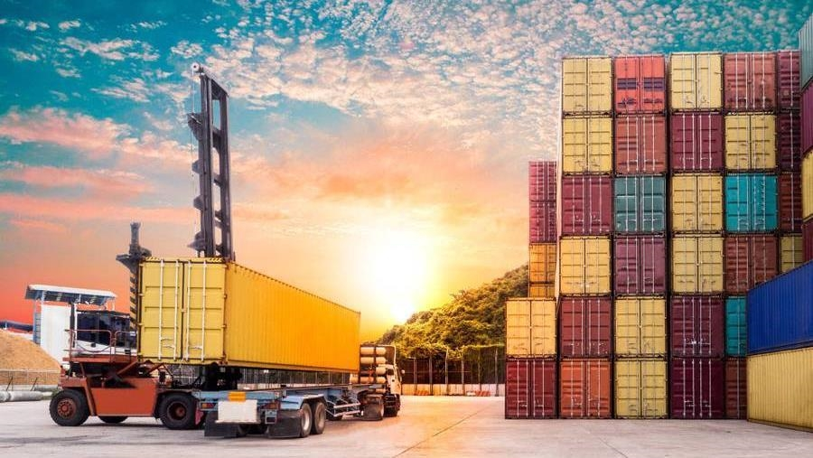
BUS TRACKING SYSTEM
LOCATION TIME MANAGEMENT

Slide 5
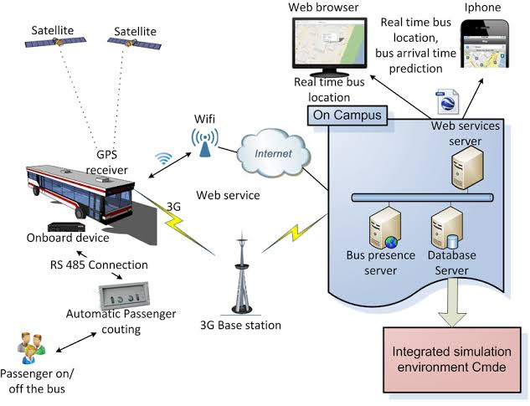
ARCHITECTURALDESIGN
According to the design, there are RFID(Radio frequency identification) tags, fixed RFID Readers, network terminals, databases, application servers and maps in the new VT(Virtual transmission) system based on RFID. All these physical parts can be extended according to actual applications, also can collaborate with other tracking techniques like GPS, for instance, portable RFID readers can be imported to remotely check goods in transportation. The databases and the application servers compose the data handling center of the new vehicle tracking system. This system can classified logically into six layers, namely, from bottom to top, Database Layer, Physical Layer, Network Layer, Enabled tools Layer, Application Layer and User Layer. The database layer, enabled tools layer, application layer and user layer are all implemented by the data handling centers.
20xx

Slide 6
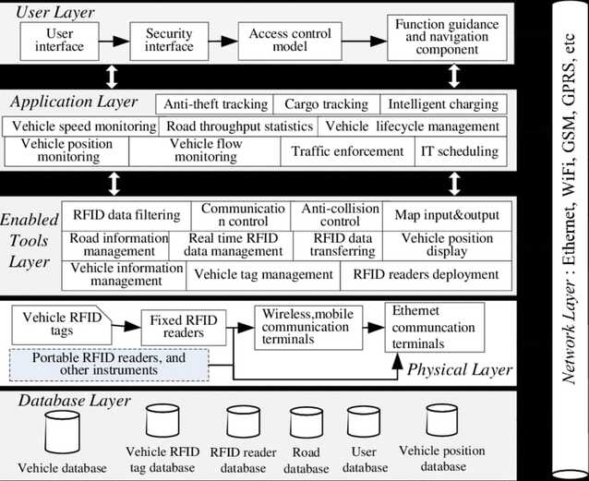
ARCHITECTURAL FLOW DIAGRAM

Slide 7
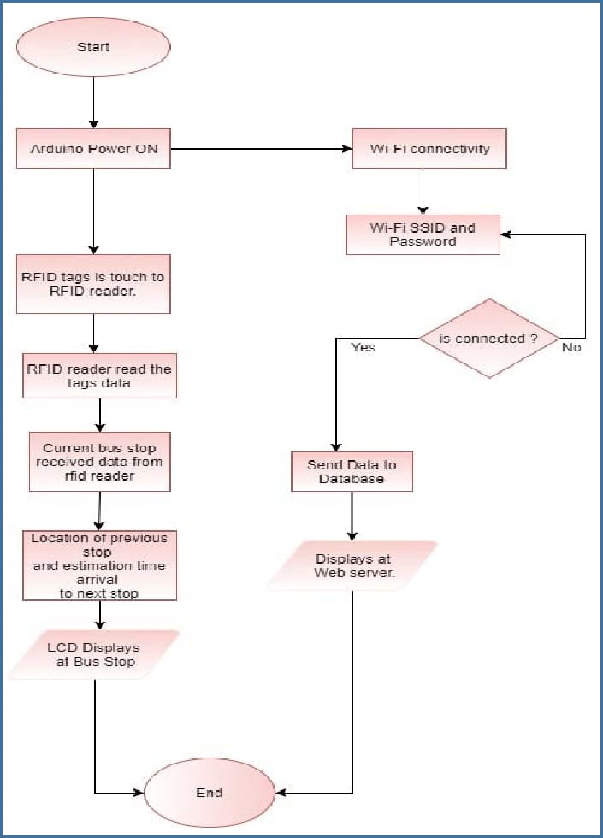
INFORMATION FLOW DIAGRAM

Slide 8
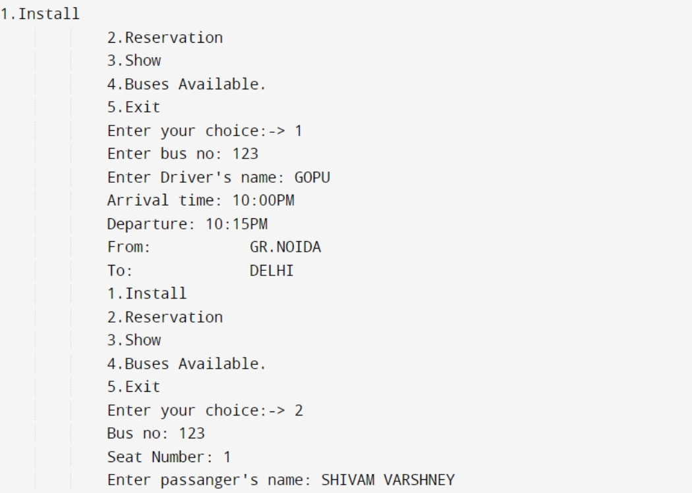
.

Slide 9
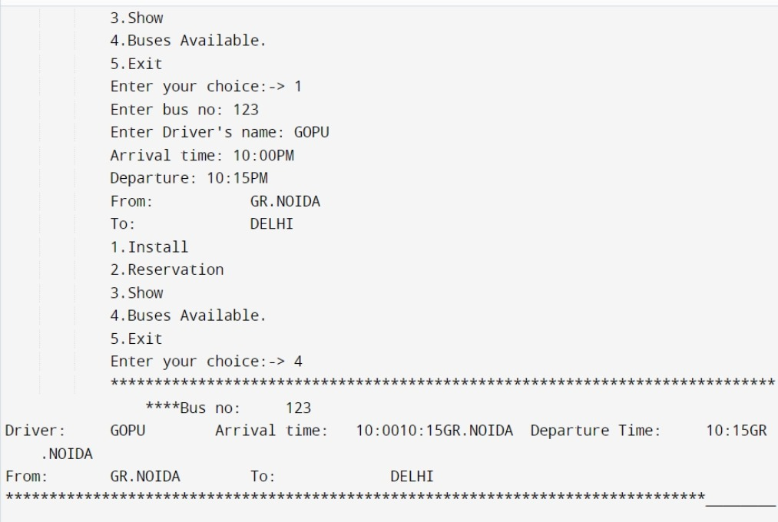
.

Slide 10
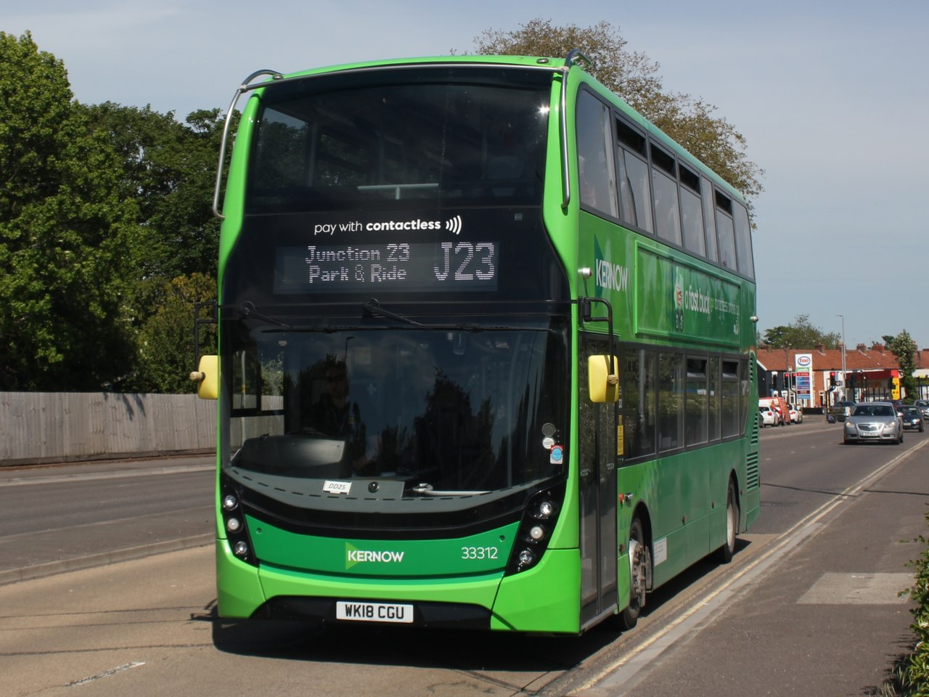
Summary
system allows a user to track their bus from the android app. With the help of tracking user can see how far the bus is this allows user to plan their route and travel plan accordingly. App will also give the approximate time and distance of the bus. This will reduce the wait time increased willingness to pay and customer satisfaction. Along with the tracking user can also buy a ticket from the app when they are in the bus. This android application will make bus transportation more productive

Slide 11
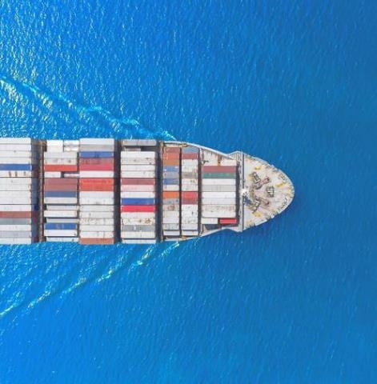
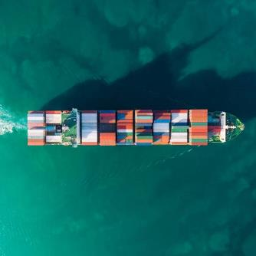
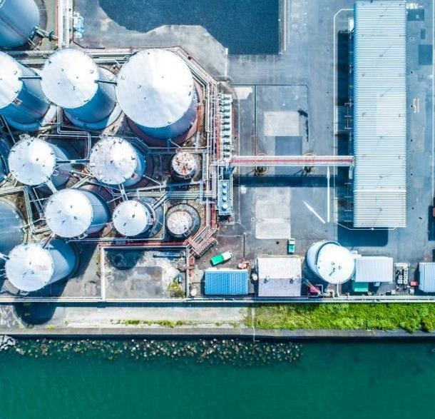
THANK YOU
Presenter name -Deepanshu Srivastava
Coded By - Shivam Varhsney
Designed By -Deepanshu Srivastava,
Deepanshu Chaudhary&
Ayush Singh

